Slide 1
Cognitive Science for AI
Final Remarks

Slide 2
Primary Areas of Study
Medicine - Neurology, Brain Science
Biology - Animal Behavior, Evolution
Psychology - Cognitive (learning, senses, cognition), Developmental (how babies develop into adults)
Linguistics - Theory, Languages, Psycholinguistics
Philosophy - Epistemology, Philosophy of Mind, Philosophy of Science
Sociology, Anthropology, Economics, Psychiatry/Abnormal Psychology
Computer Science - computational methods/complexity, Artificial Intelligence
Statistics - Regression, Predictive Analytics, Data Science
Mathematics - Logic
Mechanical, Electrical, Industrial Engineering - robotics, control mechanisms, optimization

Slide 3
What Goes Into Intelligence
What you’re born with
Genes/DNA - help build into proteins, cells, tissues, bodies
Biochemical environment for developing a body and brain from those genes
Ability to speak and think
What you live in
Language environment - what people say and how they respond
Physical environment - enough resources to allow learning
Social environment - relations with others
Interaction of the two

Slide 4
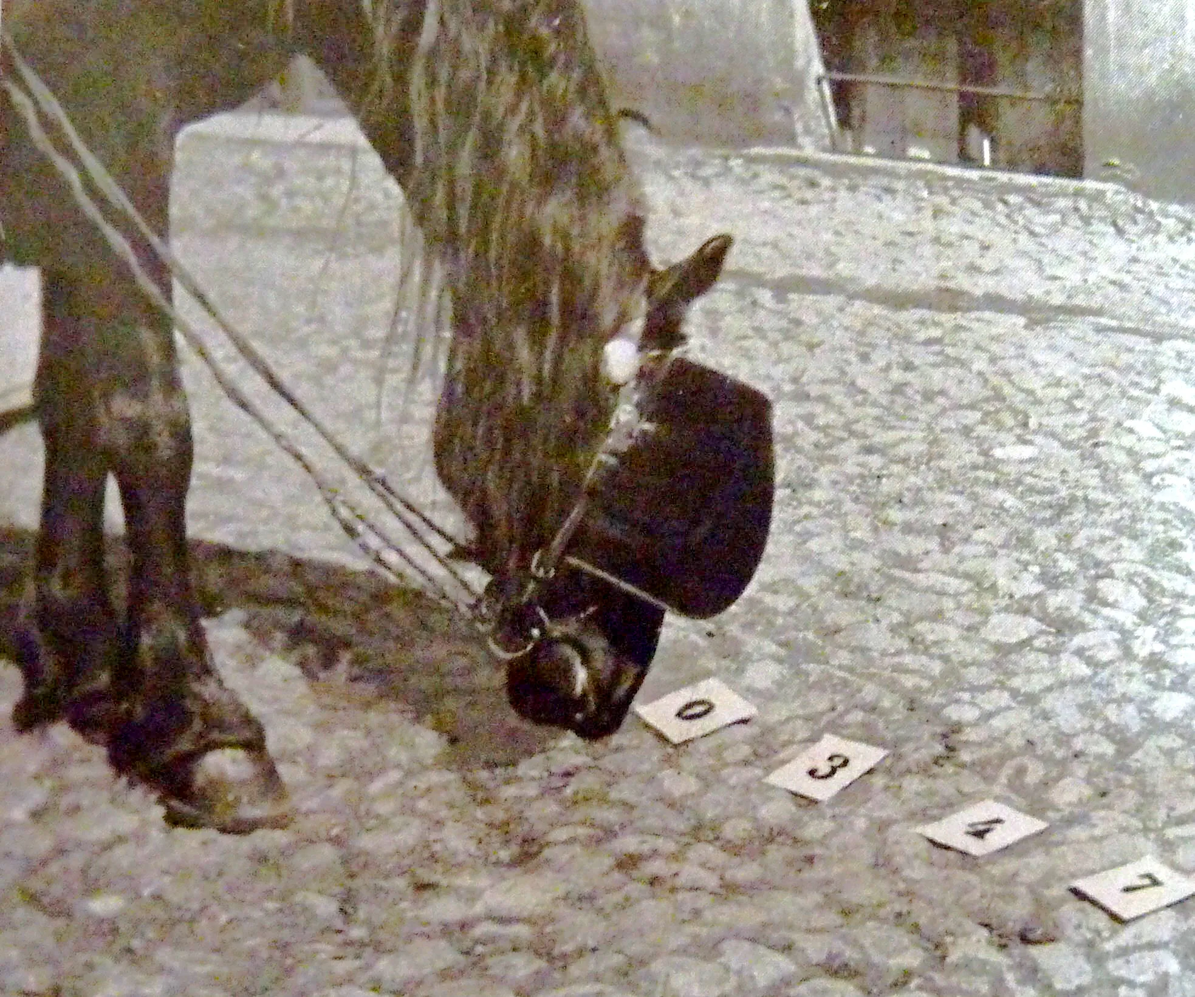
Clever Hans
A horse that does simple arithmetic
"If the eighth day of the month comes on a Tuesday, what is the date of the following Friday?"
Clever Hans would tap out…
11
When experimenter not visible to horse, accuracy drops to random
What exactly is being tested?
Arithmetic? Reading?
Classic experimental errors
Anthropomorphism
Benefit of the doubt
Confirmation bias
Hans was indeed clever, just not like we expect.

Slide 5
Beware of…
Metaphors - “The machine is ‘learning’”-> “The machine is learning”
Anthropomorphization - “the machine acts like a human, it’ll be human in other things.”
Introspection - our own thoughts are biased towards ourselves, everyone else will think the same
Projection - unconsciously, we see in others (and machines) what we see in ourselves
Magical thinking - believing a causal connection with no plausible causal link
Motivated thinking - “I want this so bad to be true…”, rationalization
Overgeneralization - “The hypothesis works on this small data set, it’ll work everywhere else too”

Slide 6
Meta points
Every bullet point is a world - Wikipedia is a poor man’s explanation. Go further - watch video(s), read a book, talk to people, take a class, etc…
It looks like we know a lot and it feels like there are just known details missing from the bullet points, but there’s so much more that we just don’t know

